Slide 1
CSC301
Creational design patterns: Dependency Injection, Factory Method, Builder, Singleton
CSC301, Winter 2016

Slide 2
Construction versus Use
When designing a system, we distinguish between construction and use
Construction = Creating an instance of some concrete class
Use = Calling methods on an object
Do not need to know the object’s concrete class,
Only need to know that it implements certain interface(s)
The distinction between construction and use (aka maintenance) happens in construction engineering as well:
Construction site is very different than a building full of tenants
Different needs & priorities, different rules, different services needed, etc.
Notes:
Ex: Construction site vs. Running Hotel

Slide 3
Construction versus Use
Generally good design (especially for large systems):
Most of the application is written in terms of interfaces
Introduce objects whose sole responsibility is constructing other objects
These are the only objects that depend on concrete implementations
Make the boundary between construction and use clear
Ensure it is easy to swap in different implementations
Notes:
E.g.: Planning a road trip without knowing exactly which car model we’re going to rent.

Slide 4
Dependency Injection
Dependency Injection (DI) is a simple pattern/technique:
A class should avoid instantiating its own dependencies
By using the new keyword, or by calling some static function
Instead let someone else inject these dependencies
By passing them as constructor arguments, or using setter methods
Important: Dependencies are declared using interfaces
NOT using concrete implementations
Who is that “someone else” that injects dependencies?
Could be a main method
Or something more elaborate like a dependency injection container (e.g., Spring, Guice)

Slide 5
Dependency Injection
At a high-level, a dependency Injection container is responsible for:
Mapping between interfaces and concrete implementations
Instantiating the concrete implementations
In practice, DI containers can become fairly complex (and hide a lot of the complexity involved of large-scale object-oriented applications)
Here is a short video explaining dependency injection
Warning: If you’re using dependency injection for a small project, there is a good chance you are over-engineering your application.

Slide 6
Designing Interfaces
Why is it good to design your application in terms of interfaces?
Allows you to focus on the domain problem and ignore implementation details
This also results in code that is cleaner and easier to read
Can use different implementations
Gradual improvements
Support different integrations
E.g.: Different sign-in providers, such as Google, Facebook, GitHub, etc.
Easier to test (we can inject test doubles for testing purposes)
Notes:
Analogy: You can plan a road trip without knowing which car rental company you’ll use, or what’s the exact model of the car you’ll be renting.

Slide 7
Stating The Problem
Problem: In some cases, your application needs to instantiate dependencies during runtime, but you still want to avoid depending on concrete classes
In other words … An application needs to create instances of type T
T is an interface (or an abstract class)
The application must not depend on any specific implementation of T (i.e., it must NOT construct objects of type T by itself)
The application depends only on T, and has to work with any implementation of T
Notes:
Ex: A car-rental application … rent a Vehicle, not a Subaru.

Slide 8
Why Is It a Problem?
What’s wrong with depending on a specific implementation?
The specific implementation might not exist,
you might want to replace it in the future,
It might not be the one you want to use for testing,
When the specific implementation changes, you need to recompile the whole application
In other words … Lack of flexibility

Slide 9
Solution
Intuition: Application delegates the responsibility (of creating objects of type T) to someone else
Let “someone else” invoke constructors (of various implementations of T)
Depend on that “someone else” instead of on any specific implementation of T
For flexibility, the “someone else” should be an interface (and not a concrete class)
Notes:
question to class: what’s the matter of using explicit constructors again?

Slide 10
The Factory Method design pattern is one way to implement our intuition.
Let’s see some diagrams describing the Factory Method pattern …

Slide 11
Step 1: The application invokes the constructors of different implementations of T.
class A
implements T
Application
class B
implements T
class C
implements T

Slide 12
Step 2: Application depends on factory objects to construct instances of type T.
Factory objects invoke the constructors of different implementations of T.
class Factory1
public T createInstance()
class A
implements T
Application
class Factory2
public T createInstance()
class B
implements T
class Factory3
public T createInstance()
class C
implements T

Slide 13
Step 3: Application depends only on the factory interface. Any factory implementation can be used to constructs instances of type T.
class Factory1
implements Factory
public T createInstance()
class A
implements T
Application
interface Factory
public T createInstance()
class Factory2
implements Factory
public T createInstance()
class B
implements T
class Factory3
implements Factory
public T createInstance()
class C
implements T

Slide 14
We can simplify the codebase using functional interfaces.
Instead of defining the Factory interface (which has a single method that takes no arguments and returns an object of type T), use Supplier<T>.
class Factory1
implements Supplier<T>
public T get()
class A
implements T
class Factory2
implements Supplier<T>
public T get()
class B
implements T
class Factory3
implements Supplier<T>
public T get()
class C
implements T
Notes:
Supplier<T> - from java.util.function.
This is a functional interface and can therefore be used as the assignment target for a lambda expression or method reference.

Slide 15
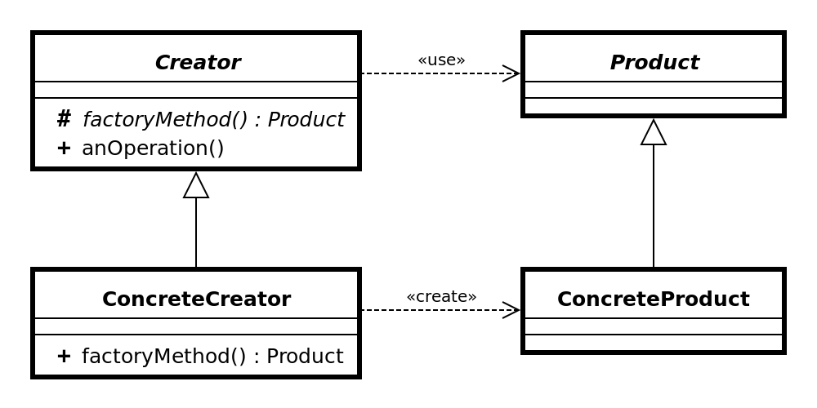
Or, if you prefer UML...

Slide 16
The Factory Method Design Pattern
Delegate responsibility
Don’t construct objects of type T yourself!
Ask a factory object to do it for you
Make the factory an interface
With a single method that returns T
Different implementations of the factory interface return different implementations of T
Notes:
question to class: what’s the matter of using explicit constructors again?

Slide 17
Factory Method
Let’s see a code example …

Slide 18
Abstract Factory
Related design pattern: Abstract Factory
Very Similar to Factory Method, except that the factory interface defines multiple methods
Instead of creating just one (type of) object, we define an interface for creating “families of related or dependent objects”
Can be implemented using Factory Methods (but there are other options as well)

Slide 19
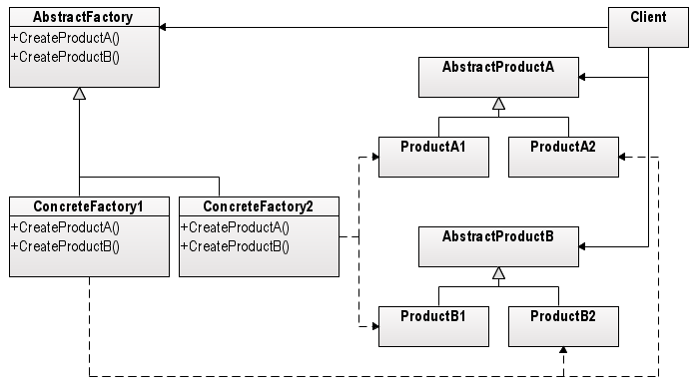
Abstract Factory UML Class Diagram
<<create>>
[Wikipedia, with minor changes]
<<create>>

Slide 20
Factory Method vs. Abstract Factory
Difference in implementation - Inheritance vs. Composition
When implementing a Factory Method interface, the implementing class is a factory (inheritance)
When implementing an Abstract Factory interface, the implementing class has a factory (composition)

Slide 21
Let’s see another creational design pattern that solves a slightly different problem ...

Slide 22
Telescoping Constructor
Telescoping Constructor
A constructor with many arguments
Possibly of the same type
E.g.:
new CanadianAddress("Apt 1A",
"301", "College", "St.",
"Toronto", "Ontario",
"B4D C4T");

Slide 23
Telescoping Constructor
Error prone
Correctness might depend on argument order
Developers might get it wrong (Or, waste time double checking)
Compiler cannot save you
Harder to test
More arguments ⇒ Even more combinations to test
Results in ugly code

Slide 24
The Builder Pattern
Break construction into two separate tasks:
Collecting arguments
Creating the instance
Solve the telescopic constructor problem by collecting the arguments one at a time
Improves code quality

Slide 25
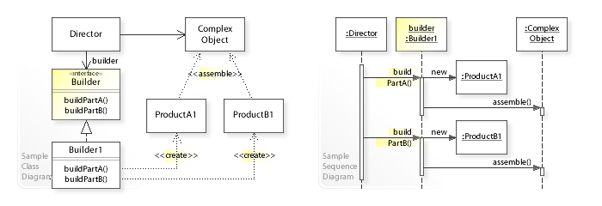
Builder UML Class Diagram
[Wikipedia]

Slide 26
Builder
Let’s see a code example …

Slide 27
Builder, Argument Validation
Perform simple validation when collecting arguments
Null, empty string, negative number, etc.
Perform (semantic) validation in build()
Conditions that involve multiple arguments
E.g.: Conflicting postal code and province

Slide 28
Singleton
Another creational design pattern
Ensures that only one instance of a certain class can be created
E.g.:
public class Foo {
private static Foo instance = null;
public static Foo getInstance(){
if(instance == null){
instance = new Foo();
}
return instance;
}
}
Note: Implementation is slightly more complex for multi-threaded programs.

Slide 29
Singleton
Controversial design-pattern
Feels like a global
Considered an anti-pattern by some people
Think twice before using it
There are cases where singleton is the right solution, but they are fairly rare
E.g., difficult to test (cannot substitute with a mock)

